Slide 1
Unsupervised Curricula for Visual Meta-Reinforcement Learning
Allan Jabri, Kyle Hsu, Ben Eysenbach, Abhishek Gupta, Sergey Levine, Chelsea Finn
NeurIPS 2019

Slide 2
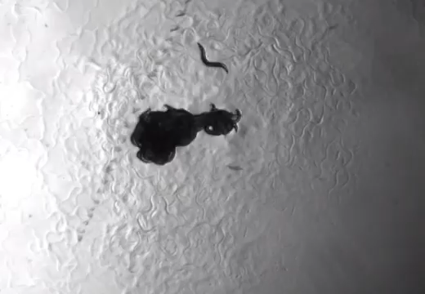
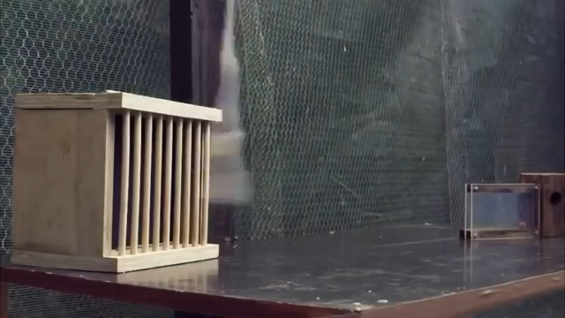
A Need to Generalize
C elegans
C. Elegans, foraging
New Caledonian Crow
applying tools
Notes:
The environments of our world are dynamic and changing.
Even simple animals like the c elegans have evolved to adapt foraging strategies to varying scenarios.
Smarter species like the New Caledonian crow even develop tools in order to generalize to new problems

Slide 3
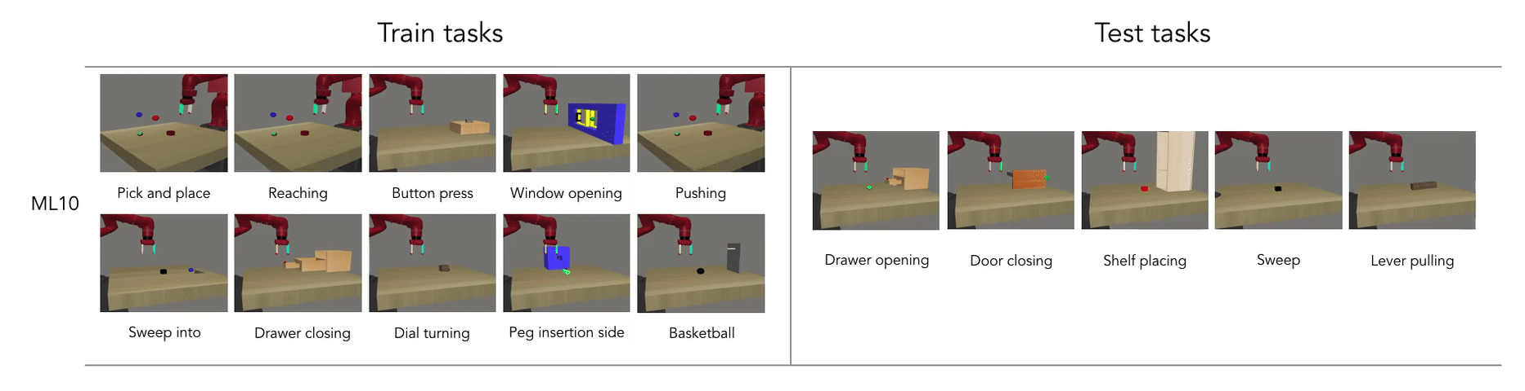
From Specialist to Generalist
Source: Meta-World
meta-world.github.io
Notes:
In RL, we’ve managed to build specialists that solve certain tasks very well.
We want to efficiently build systems that generalize
Transfer of function
Requirement of less direct supervision
Multi-task learning
Meta-learning
Continual learning
Unsupervised learning
…

Slide 4
Multi-task Reinforcement Learning
Contextual Policies
Condition policy on
given task description
e.g. a goal
Meta-learning for RL
Condition policy on
description of task inferred
from data collected by policy
more general

Slide 5
Meta-Reinforcement-Learning
Condition policy on
description of task inferred
from data collected by policy
Recurrent policy learns to infer task by collecting the right data
Notes:
Note: See each task multiple times, consecutively

Slide 6
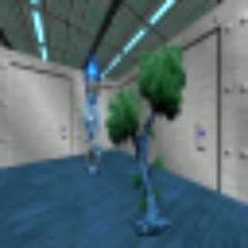
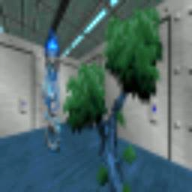
With pixel observations
The meta-learner learns to search for and associate
stimulus and reward.

Slide 7
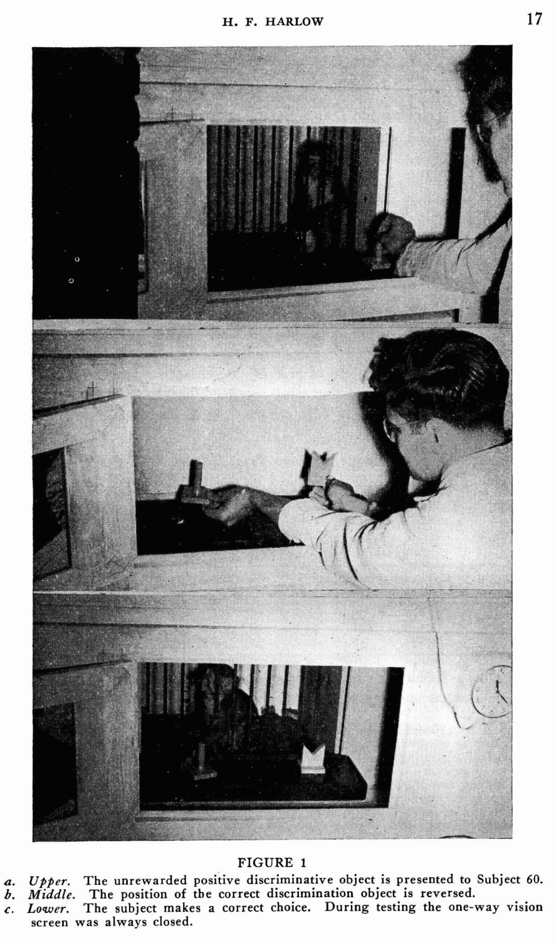
Meta-RL from Pixels
The formation of learning sets. 1949

Slide 8
The Task Distribution
Meta-training tasks determine acquired
task inference and execution strategies
Notes:
–> extent of potential transfer
–> tedious to enumerate, tricky to design

Slide 9
Can we learn useful meta-RL strategies with tasks formed without supervision?

Slide 10
Unsupervised Pre-training
learned model providing
reward functions for meta-learning
i.e. obtain a task distribution by modeling data from environment

Slide 11
Goal: Prepare a visuomotor agent with useful RL strategies by pre-training with self-generated tasks.

Slide 12
Unsupervised Pre-training
Transfer to Test Tasks

Slide 13
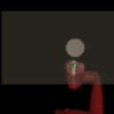
Tasks
Task Acquisition
Unsupervised discovery of tasks
Meta-learning
Learn to learn to solve tasks
Notes:
Prior work: Treat separately, from ground-truth low-dim state
CHALLENGE: JOINT OPTIMIZATION

Slide 14
Tasks
Task Acquisition
Unsupervised discovery of tasks
Meta-learning
Learn to learn to solve tasks
Data?
Notes:
Prior work: Treat separately, from ground-truth low-dim state
CHALLENGE: JOINT OPTIMIZATION

Slide 15
Tasks
Task Acquisition
Unsupervised discovery of tasks
Meta-learning
Learn to learn to solve tasks
Data?
Task distribution should adapt
Notes:
Goal: Prepare a visuomotor agent with useful RL strategies by pre-training with self-generated tasks.
Prior work: Treat separately, from ground-truth low-dim state
CHALLENGE: JOINT OPTIMIZATION

Slide 16
Criteria for Task Distribution
Diversity
Structure
Notes:
The point is to prepare for generalization.
Here, we show the space of trajectories and

Slide 17
Criteria for Task Distribution
Diversity
Structure
Notes:
The point is to prepare for generalization.
Here, we show the space of trajectories and

Slide 18
Formulation
Policy
Post-update trajectories
Task scaffold
Task latent variable

Slide 19
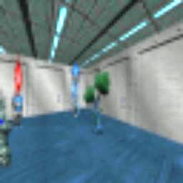
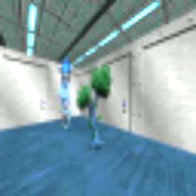
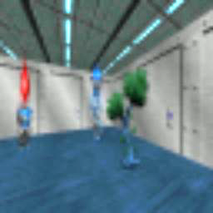
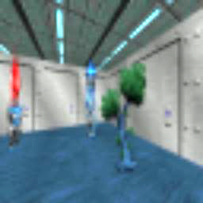
Data
+
1. Organize
2. Meta-Train
+
Update task scaffold
+
Update policy
Tasks

Slide 20
Data
+
1. Organize
2. Meta-Train
+
Update task scaffold
+
Update policy
Tasks
E-step
M-step

Slide 21
Task Acquisition (E-step)
Trajectory-level discriminative clustering

Slide 22
Task Acquisition (E-step)
Trajectory-level discriminative clustering
Conditional independence assumption

Slide 23
Meta-train (M-step)
Policy learns updated task distribution
+
i.e.
+
+

Slide 24
Meta-train (M-step)
Policy learns updated task distribution
+
i.e.
+
+
Density-based Exploration

Slide 25
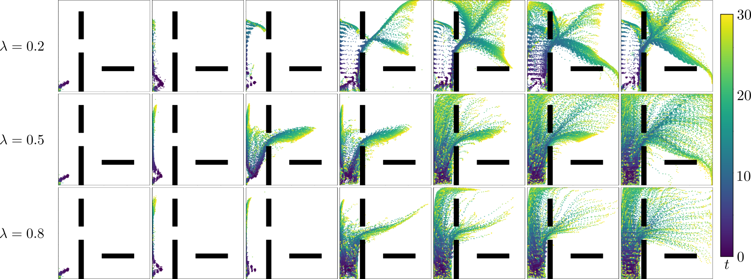
Effect of
Structure v. Diversity

Slide 26
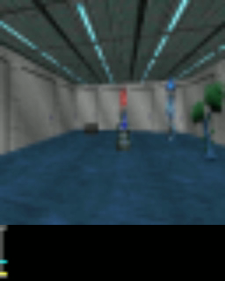
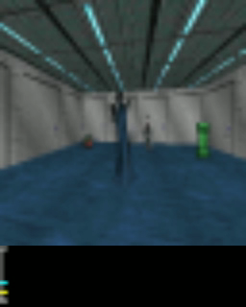
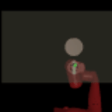
Experimental Setting
Visual Navigation
in VizDoom
Object Pushing
with Sawyer in MuJoCo

Slide 27


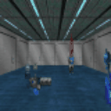
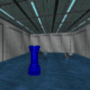

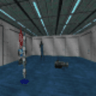
What kind of tasks are discovered?

Slide 28
What kind of tasks are discovered?
Start

Slide 29




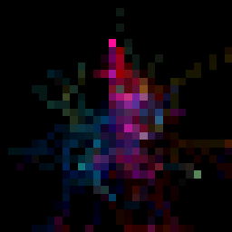







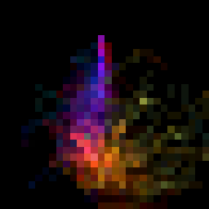
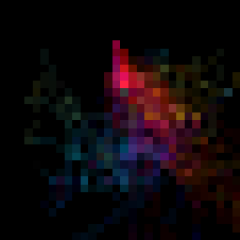




What kind of tasks are discovered?
Step 1
Step 5

Slide 30

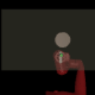
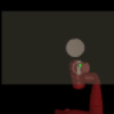
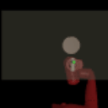
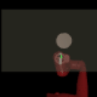
What kind of tasks are discovered?

Slide 31
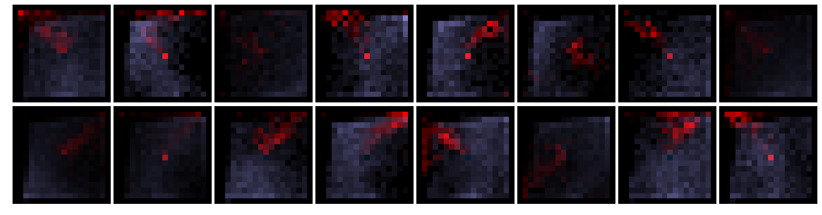
What kind of tasks are discovered?

Slide 32
Transfer to Test Tasks – VizDoom
Direct Transfer
Notes:
Do these tasks allow for meta-training of strategies that transfer to test tasks?

Slide 33
Transfer to Test Tasks – VizDoom
Faster
Finetuning
Notes:
Do these tasks allow for meta-training of strategies that transfer to test tasks?

Slide 34
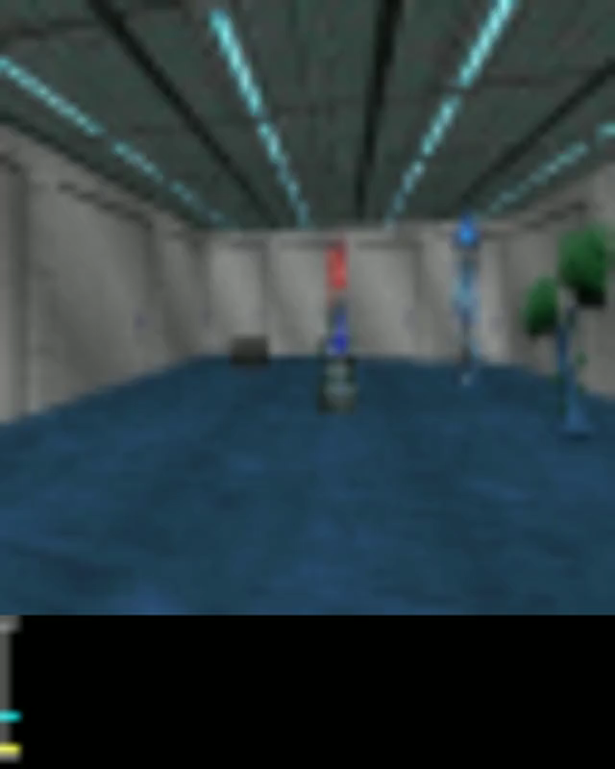
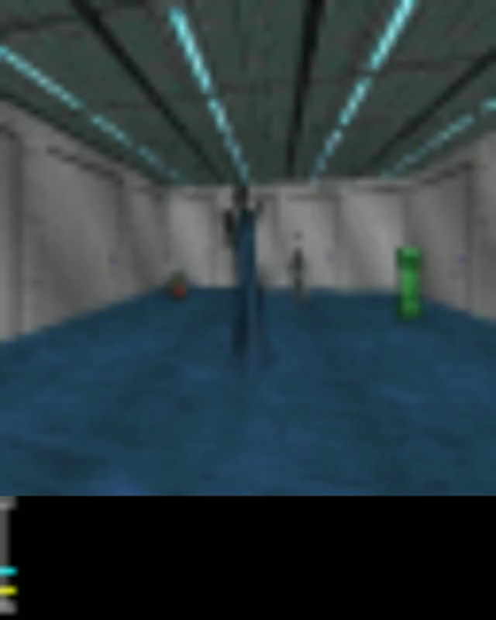
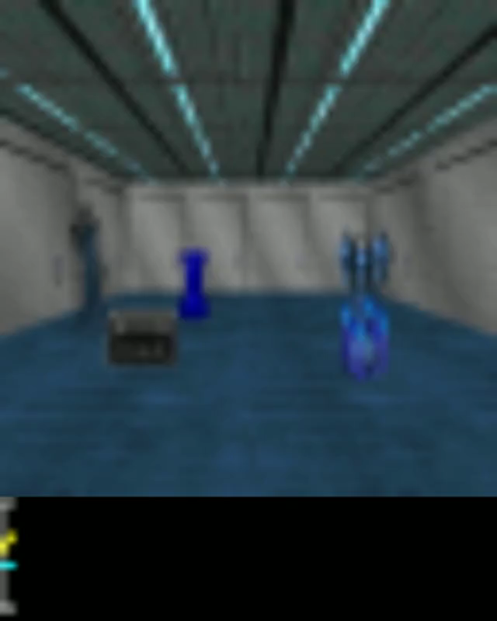
Transfer to Test Tasks – VizDoom
Reward
Episode boundary

Slide 35
Transfer to Test Tasks – Sawyer
Direct Transfer
Notes:
Do these tasks allow for meta-training of strategies that transfer to test tasks?

Slide 36
Transfer to Test Tasks – Sawyer
Faster
Finetuning
Notes:
Do these tasks allow for meta-training of strategies that transfer to test tasks?

Slide 37
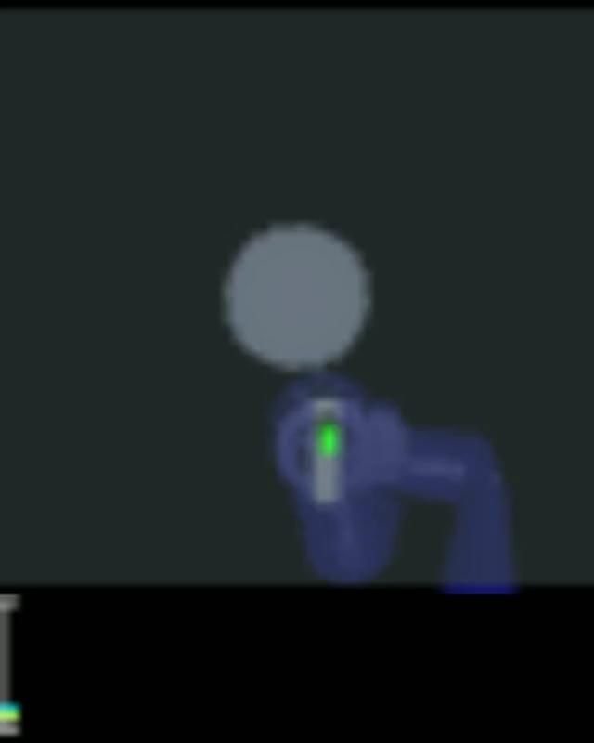

Transfer to Test Tasks – Sawyer
Reward
Episode boundary

Slide 38
Variants
Notes:
We also compare to variants of our method, that use different task acquisition procedures.

Slide 39
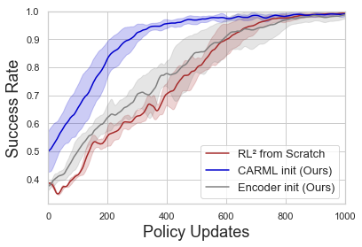
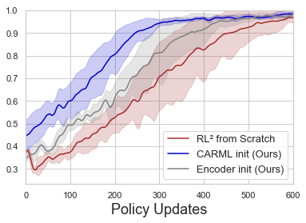
Faster Supervised Meta-RL

Slide 40
Thank You
Kyle Hsu
Ben Eysenbach
Abhishek Gupta
Sergey Levine
Chelsea Finn
Poster #35, East Exhibition Hall B + C
https://sites.google.com/view/carml

